Slide 1
Crawl-Trainer Progress Report Group 9
Tomisin Akinyemi, Katherine Lauer, Lauren Pickman

Slide 2
Background
Creating a crawling assistive device as an early intervention method for children with gross motor delay.
8.7% of infants have gross motor delay
Gross motor delay can be caused by genetic disorders, premature birth, neuromuscular disorders, or developmental disorders

Slide 3
Overview
Project Changes
Design Alternatives and Analysis
Chosen Solution

Slide 4
Project Changes

Slide 5
Updated Design Specifications
Specification | Description
Safety | All materials must be non-toxic and safe for children with no sharp edges or dangerous components. The device must keep children in safe body positions to prevent injury.
Weight Bearing | Must provide trunk support. This must support up to 18 kg, which is the 95th percentile weight of a 3 year old.
Bouncing motion | Must create a slight up-and-down bouncing motion or “springiness” in order to provide sensory stimulation which helps to interrupt ataxic muscle movements.
Contact spatial awareness | Must keep child grounded in space via gravitational awareness, with minimal visual or physical obstruction of their surroundings.
Range of motion | Child must be able to navigate and pivot around in all directions.
Updated
New

Slide 6
Updated Gantt Chart

Slide 7
Design Alternatives

Slide 8
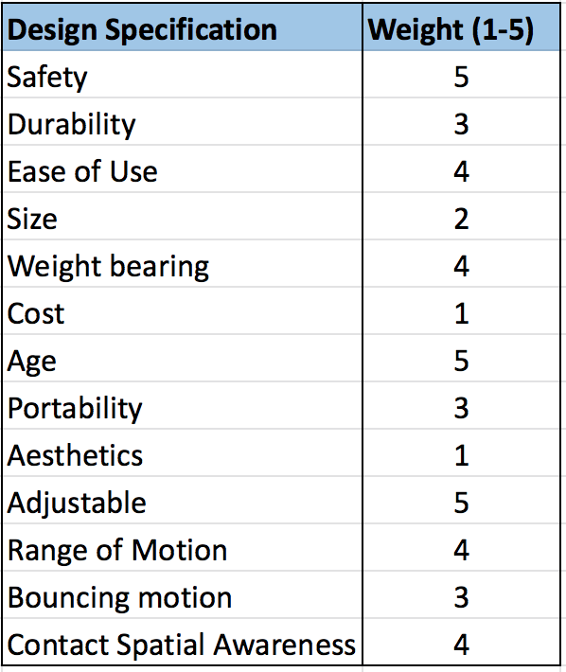
Pugh Chart categories
Highest Weighted
Safety: Materials are non-toxic with no sharp edges. Puts child in a safe body position.
Age: Can be used by ages 1-3
Adjustable: Can be adjusted to accommodate a wide array of heights, to account for growth

Slide 9
Pugh Chart categories
Highest Weighted (5)
Safety
Age
Adjustable
Other Important Factors (4)
Ease of Use
Weight Bearing/Support
Range of Motion
Contact Spatial Awareness

Slide 10
Considered Designs
DIY Inspired Solutions
Trunk Support on Wheels
Modified Skateboard
Sensor-Feedback System
Motion Sensor Suit
Robotic
Suspension
Automated Leg Exoskeleton
Multi-Point Bungee System
Foam Roller
Hand-Held Sling
Table Support
Neoprene Sling
Crawl-Trainer
Wall-Mounted Sensors

Slide 11
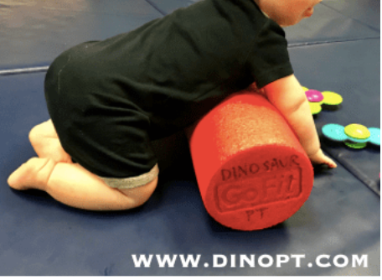
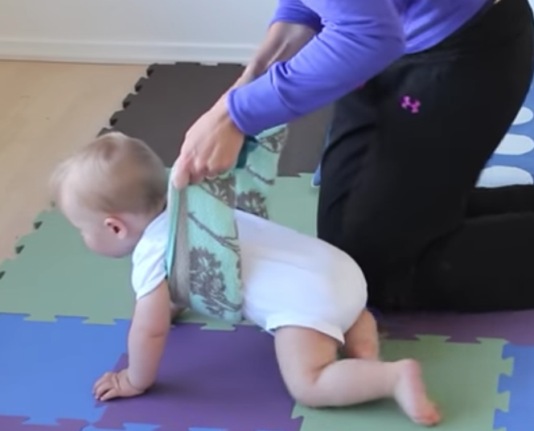
DIY Solutions: Foam Roller and Hand-Held Sling
PROS
Inexpensive
Durable
Portable
Small
CONS
Unsafe
Requires proper training/technique for adult
Limited range of motion
How to Teach Baby to Crawl , Baby Exercises and Activities, 26 May 2015, https://www.youtube.com/watch?v=s0eVO50vddA&feature=youtu.be
Talmud, Rebecca. “Teaching Children to Crawl.” DINOSAUR PHYSICAL THERAPY, 26 July 2016, https://blog.dinopt.com/teaching-children-to-crawl/.

Slide 12
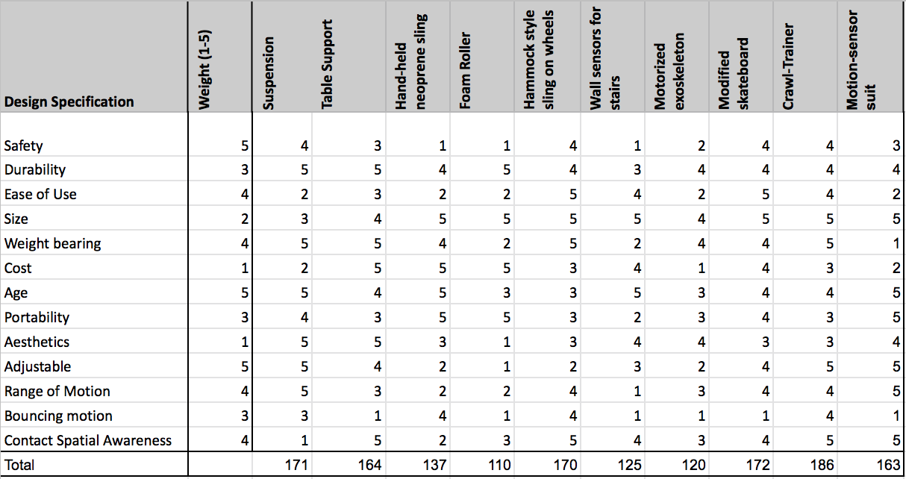
DIY Solutions: Foam Roller and Hand-Held Sling
Both have lowest possible safety score
Neoprene Sling Rank: #7 out of 10
Foam Roller Rank: #10 out of 10

Slide 13
Sensor-Feedback: Wall-Mounted Sensors
PROS
Does not take up much space
Works for many ages
CONS
Need additional trunk support
Limits range of motion
Concerns with pets or children playing with electrical components
No bouncing motion

Slide 14
Sensor-Feedback: Motion Sensor Suit
PROS
Custom to fit specific child
Portable
Unrestricted motion
CONS
Expensive – need multiple suits as child grows
Safety concerns with electrical components so close to child
Need additional trunk support
No bouncing motion

Slide 15
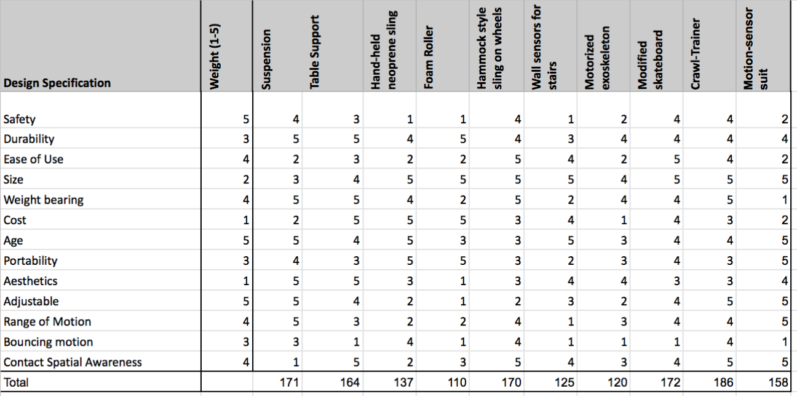
Sensor-Feedback: Pugh Chart
Rank: #8 of 10
#6 of 10

Slide 16
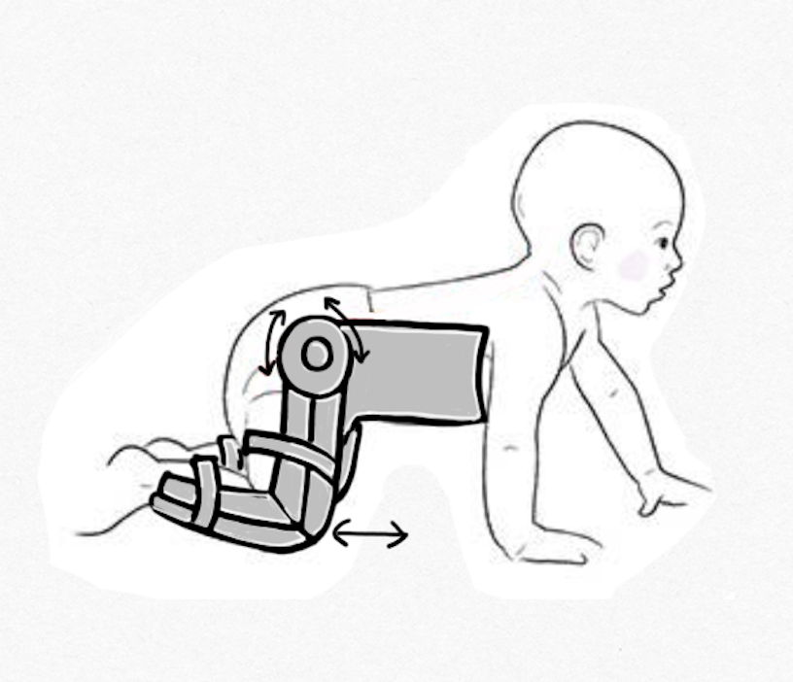
Robotic: Automated Leg Exoskeleton
PROS
Proper positioning with trunk support
Custom fit to child
CONS
Cost
No bouncing motion sensory input
Passive motion
Proximity of circuitry to child’s body

Slide 17
Robotic: Pugh Chart
Rank: #9 of 10

Slide 18
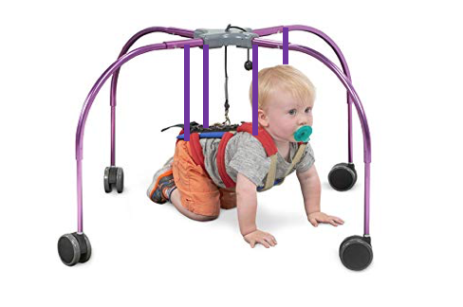
Suspension: Multi-Point Bungee System
Adjustable bungee cords above key weight bearing points: trunk, shoulders, hips
PROS
Adjustable height
Some bouncing motion for sensory stimulus
Weight bearing
CONS
Limits gravitational/spatial awareness -> ”floating” sensation
Multiple straps and harness are difficult to use
Need professional to properly adjust bungee cords
“CrawlAhead.” CrawlAhead | LiteGait.com, LiteGait, https://litegait.com/products/CrawlAhead.

Slide 19
Suspension: Pugh Chart
Rank: #3 of 10

Slide 20
Trunk Support on Wheels: Table Support
PROS
Considered modifying the device below with higher sides and a body strap
Adjustable height
Trunk support
Durable
Spatial awareness
CONS
No bouncing motion for sensory input
Bulky
“Adjustable Crawl Trainer.” Flaghouse, Flaghouse, https://www.flaghouse.com/Positioning-Mobility/Crawling/Adjustable-Crawl-Trainer.axd.

Slide 21
Trunk Support on Wheels: Neoprene Sling
PROS
Some bouncing motion for sensory stimulus
Range of motion
Spatial awareness
Neoprene
CONS
Potential need for multiple slings: need to support correct points on chest and hips

Slide 22
Trunk Support on Wheels: Modified Skateboard
PROS
Ease of use
Would work for children 1-3 with minimal adjustments
Range of motion
CONS
Does not put child in a proper crawling position
No bouncing motion

Slide 23
Trunk Support on Wheels: Pugh Chart
#5 of 10
#4 of 10
#2 of 10

Slide 24
Chosen Solution

Slide 25
The Crawl-Trainer
Wheels: Allow motion in all directions
Padded foam top: Fits to child’s body and decreases discomfort
Body strap and high sides: Keeps child safely in place with proper positioning
Adjustable bar: Can adjust to correct height for children ages 1-3

Slide 26
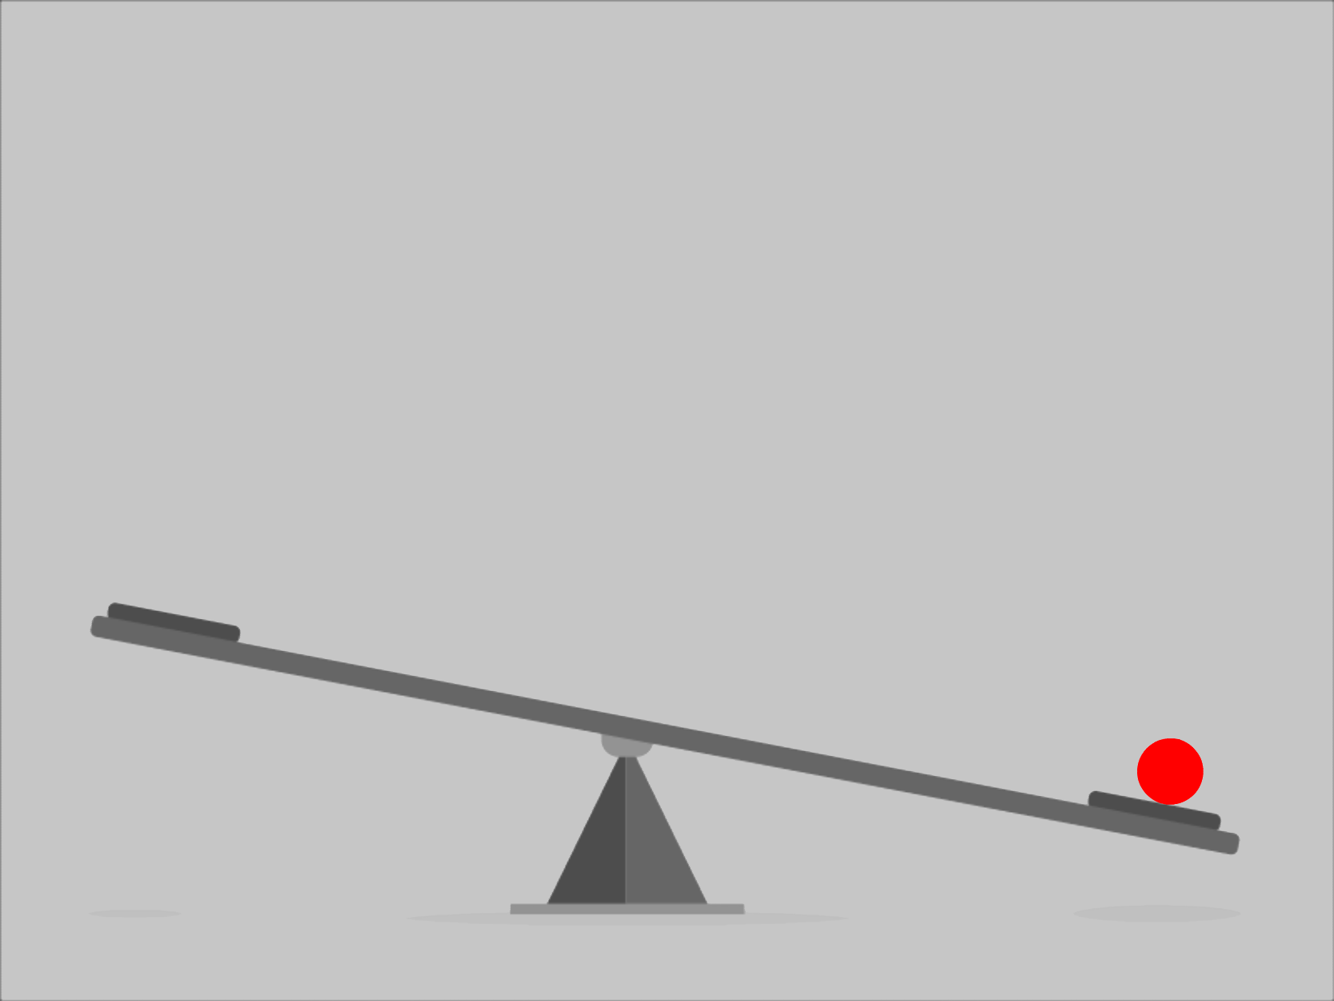
The Crawl-Trainer
Metal bars under tension:
Provide sensory feedback via bouncing motion
Angle of platform reacts to weight distribution
Bouncing/rocking motion:
Calming, sensory feedback
Breaks up ataxic movements to allow for motor planning

Slide 27
The Crawl-Trainer: Pugh Chart
#1 of 10

Slide 28
The Crawl-Trainer: Top Performer
The Crawl Trainer
Safety
Easy to use
Bouncing motion
Weight support
Adjustable
Useful for ages 1-3
Range of motion

Slide 29
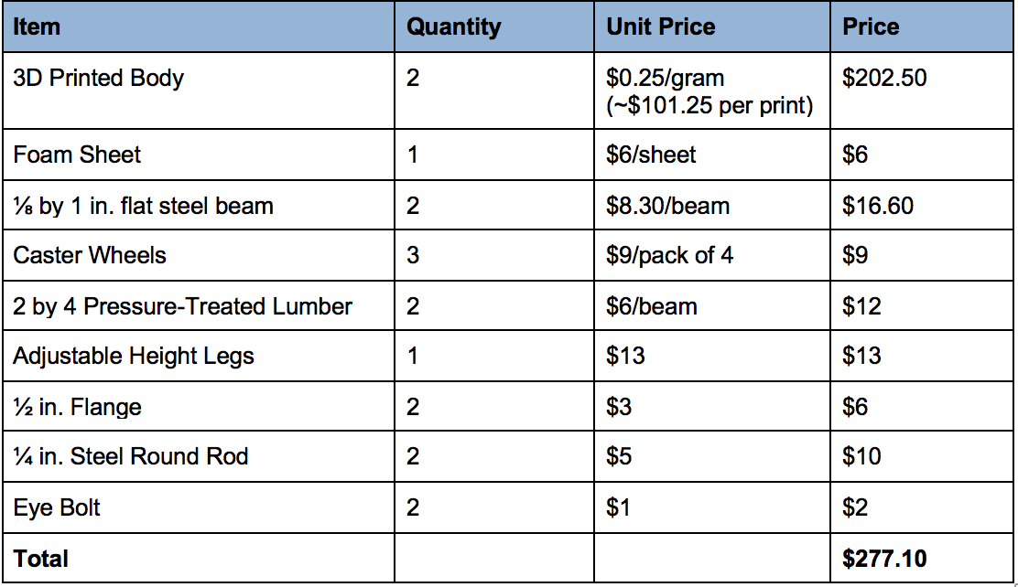
Proposed Budget

Slide 30
Questions?

Slide 31
Sources
“Adjustable Crawl Trainer.” Flaghouse, Flaghouse, https://www.flaghouse.com/Positioning-Mobility/Crawling/Adjustable-Crawl-Trainer.axd.
“CrawlAhead.” CrawlAhead | LiteGait.com, LiteGait, https://litegait.com/products/CrawlAhead.
How to Teach Baby to Crawl , Baby Exercises and Activities, 26 May 2015, https://www.youtube.com/watch?v=s0eVO50vddA&feature=youtube.
“Cross Crawling.” CogniKids, 28 Nov. 2016, https://cognikids.com/2016/01/28/cross-crawling/.
“Data Table of Infant Height-for-Age Charts.” CDC , National Center for Health Statistics, 23 Aug. 2001, https://www.cdc.gov/growthcharts/html_charts/lenageinf.htm#females.
“Data Table of Infant Weight-for-Age Charts.” CDC , National Center for Health Statistics, 23 Aug. 2001, https://www.cdc.gov/growthcharts/html_charts/wtageinf.htm#females.
Intermountain Healthcare. Gross Motor Delay: Rehabilitation: Pediatrics. n/a n/a 2017. 30 September 2019 <https://intermountainhealthcare.org/services/pediatrics/services/rehabilitation/services/gross-motor-delay/>.
McNamara, Lindsay. Ataxia Overview. 11 Feb. 2019, https://www.hopkinsmedicine.org/neurology_neurosurgery/centers_clinics/ataxia/conditions/.
Perlut PT, Susan. Personal Interview. 19 Nov. 2019.
Talmud, Rebecca. “Teaching Children to Crawl.” DINOSAUR PHYSICAL THERAPY, 26 July 2016, https://blog.dinopt.com/teaching-children-to-crawl/.

