Slide 1
Crawl-Trainer Verification & Validation Report
Group 9
Tomisin Akinyemi, Katherine Lauer, Lauren Pickman
Notes:
Good morning! I am Tomisin Akinyemi and im presenting the CrawlTrainer on behalf of group 9

Slide 2
Background
Creating a crawling assistive device as an early intervention method for children with gross motor delay.
8.7% of infants have gross motor delay
Gross motor delay can be caused by genetic disorders, premature birth, neuromuscular disorders, or developmental disorders
Notes:
Crawling builds motor skills, promotes independence

Slide 3
Overview
Project Changes
Verification Plan
FDA Process
Validation Plan
Project Status

Slide 4
Project Changes

Slide 5
Updated Design Specifications
Specification | Description
Safety | All materials the child is in contact with must be non-toxic and safe for children with no sharp edges or dangerous components. The device must keep children in safe body positions and must not fall over during normal use to prevent injury.
Durability | Must be able to withstand daily therapeutic use for 2 years and be easily repairable using common household tools.
Adjustable | Must be able to accommodate the height of children ages 1-3, which ranges from approximately 70 - 100 cm. Based on measurements taken of a child in a crawling position and looking at average children’s heights and limb measurements, the height from the floor to the torso support of the device should be no shorter than 9 cm and should be able to increase by at least 6 cm.
Bouncing Motion | Must create a forward and backward rocking motion or “springiness” in order to provide sensory stimulation which helps to interrupt ataxic muscle movements.
Notes:
Implemented new design specifications and updated old ones which is shown by the parts in bold
Safety: We added that the device must keep children safe and in correct body positions for crawling
Device must provide trunk support besides just holding the child’s weight
Worked with a physical therapist who specifically noted how well the child responds to having this slight bouncing motion. Has two benefits: sensory feedback and calming and also Helps break up ataxic or irregular muscle movements caused by neurological disorders which helps for motor planning
Contact Spatial Awareness: also from feedback from PT. says its important for child to feel grounded in space and feel the effects of gravity. Some devices relieve weight by pulling from above which creates a floating feeling that children do not like
Range of motion: not impeding directions they can travel in

Slide 6
Updates to Design Specification
Safety
Durability
Adjustability
Spring Support
Materials
Stability
Therapeutic Use
Height of Torso must range from 9-15 cm
Direction (Front to Back)
Notes:
Safety – updated to emphasize only materials the child comes in direct contact with must be non-toxic/safe for children. Also to ensure that the device can balance and does not fall over during use
Durability – updated to indicate the device must be able to sustain daily therapeutic use, the child should not use the device for extended periods of time such as the entire day. The device should be used primarily for play therapy.
Adjustability – now includes adjustable height range based on average height and limb measurements of children ages 1-3
Spring Support or Bouncing Motion – updated to demonstrate the direction of the spring support, allowing for a forward and backward rocking motion.

Slide 7
Project Schedule Updated to Indicate Second Prototyping Stage
Notes:
Most of the project time has passed but the schedule was updated in order to clarify the separate Alpha and Beta prototyping stages. The Beta Prototype will be the final prototype developed by the team, using materials with higher durability than those used to construct the Alpha prototype which will be used mainly for Verification testing and design finalization. Parts of the Alpha prototype may be used to construct the Beta prototype which will be used for the Validation and the final project demonstration.

Slide 8
Verification Plan

Slide 9
Verification Will Occur Through Phased Testing During the Alpha Prototype Build
Pre-Build
Safety
During the Build
Size/Age
Final Verification
Ease of Use/Aesthetics
Cost
Portability
Adjustability
Contact Spatial Awareness
Range of Motion
Durability
Weight Bearing/Safety
Bouncing Motion

Slide 10
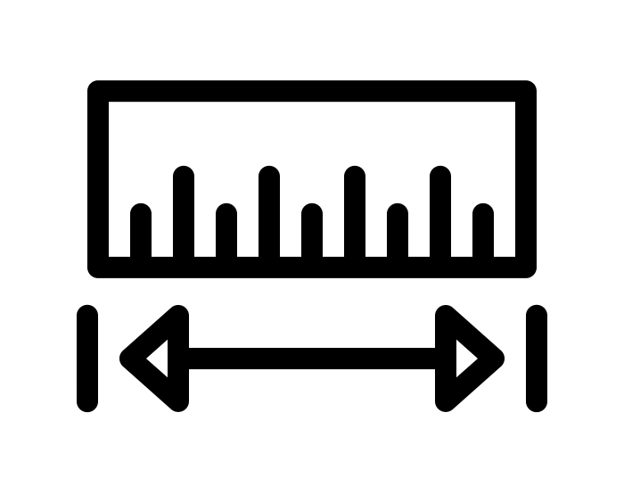
Pre-Build Testing and Research Has Been Completed
Research
Material Safety
Cost
Metrics
Size
Portability
Notes:
Material Safety and Cost were verified through research. The data sheets for the materials used in our device were utilized to ensure that all materials were non-toxic. The cost was verified through the budget sheet created and submitted to the BME department. The cost will continue to be evaluated through the prototype build process however we believe that all of the materials we will need have been procured.
The size and portability of the device will be validated pre-build through measurements taken of the parts that will be used to build the device. The overall size can be estimated based on the design and measured from the parts. The portability will be evaluated by weighing the individual parts, ensuring that overall the device will weigh under 18 kg as outlined in our design specifications. The portability of the final prototype will be validated later.

Slide 11
Testing During the Build
Size
Age
Adjustable
Contact Spatial Awareness
Range of Motion
Notes:
Continuous measurement will be used to verify the size, age, adjustability, spatial contact and range of motion metric ranges are fulfilled by our device. Again, as the device should be usable for children between the ages of 1-3, the overall size of the device should be suitable for the average to 95th percentile sizes of children in this age range. Therefore the device will have an adjustable height to ensure the limits of the range can be reached.
In order for the child to experience contact spatial awareness in the device, they must be physically grounded. This will also ensure their stability. This also depends on the height of the device and the ability for the device to balance.
We want the child to be able to explore while crawling in the device and therefore it should not inhibit their range of motion. We will ensure that the device has 360 degrees of rotation about a rotation axis while building the base and wheels of the device.

Slide 12
Final Prototype Verification Testing
Weight Bearing
Durability
Ease of Use
Aesthetics
Bouncing Motion
Notes:
Surveying – Ease of Use and Aesthetics
Weight Bearing, Bouncing Motion and Durability will be tested by applying an 18 kg load to the device as outlined in the design specifications and mimicking weight shifting.

Slide 13
Validation Plan

Slide 14
The final Beta prototype will be validated through quantitative and qualitative data acquisition during therapeutic use.
Child uses device with therapist/parent
Data acquisition and analysis
Evaluation of therapeutic effectiveness

Slide 15
5 Stages of Therapeutic Effectiveness
1
4
Sustained Reciprocal Crawling
5
Transitions Out Of Device
2
3
Independent Movement
Sustained Independent Movement
Maintains Crawling Position
Notes:
The main goals will be that the device allows the client to a) hold a proper crawling position unassisted b) increase the duration they are able to hold a crawling position unassisted c) crawl unassisted and d) crawl reciprocally unassisted​.
Stage 1:
The client is able to hold a crawling position in the Crawl-Trainer for 1 minute unassisted.
Stage 2:
The client is able to independently propel their body forward in the Crawl-Trainer, engaging visually and shifting upper body weight to initiate a cause and effect toy with either their right or left hand. Stage 3: The client is able to independently propel their body forward 10 feet in the Crawl-Trainer, engaging visually and shifting upper body weight to initiate a cause and effect toy with either their right or left hand. Stage 4: The client is able to reciprocally crawl 10 feet in the Crawl-Trainer, demonstrating bi-lateral movement. They also are able to engage visually and shift upper body weight to initiate a cause and effect toy with either their right or left hand. Stage 5: The child has transitioned out of the Crawl-Trainer device and is now able to maintain a proper crawling position and reciprocally crawl independently.

Slide 16
5 Stages of Therapeutic Effectiveness
1
4
Sustained Reciprocal Crawling
5
Transitions Out Of Device
2
3
Independent Movement
Sustained Independent Movement
Maintains Crawling Position
1
Notes:
The main goals will be that the device allows the client to a) hold a proper crawling position unassisted b) increase the duration they are able to hold a crawling position unassisted c) crawl unassisted and d) crawl reciprocally unassisted​.
Stage 1:
The client is able to hold a crawling position in the Crawl-Trainer for 1 minute unassisted.
Stage 2:
The client is able to independently propel their body forward in the Crawl-Trainer, engaging visually and shifting upper body weight to initiate a cause and effect toy with either their right or left hand. Stage 3: The client is able to independently propel their body forward 10 feet in the Crawl-Trainer, engaging visually and shifting upper body weight to initiate a cause and effect toy with either their right or left hand. Stage 4: The client is able to reciprocally crawl 10 feet in the Crawl-Trainer, demonstrating bi-lateral movement. They also are able to engage visually and shift upper body weight to initiate a cause and effect toy with either their right or left hand. Stage 5: The child has transitioned out of the Crawl-Trainer device and is now able to maintain a proper crawling position and reciprocally crawl independently.

Slide 17
Qualitative Surveying
Physical Therapist
After Initial Therapy Session
Aesthetics
Range of Motion
Parent
After Use Without PT
Aesthetics
Range of Motion
Contact Spatial Awareness
Ease of Use

Slide 18
FDA Process
Notes:
So our chosen solution also falls under the trunk support on wheels category, which makes sense seeing as the other devices in that category consistantly performed well

Slide 19
Crawl-Trainer is an FDA Class I Device
Class I Device
510(k) Report Submission
FDA Approval
Similar to PVC Walker
Low Risk
Premarket Notification Submission
Notes:
The US FDA defines Class I devices as devices which are "not intended for use in supporting or sustaining life or of substantial importance in preventing impairment to human health, and they may not present a potential unreasonable risk of illness or injury."
Class I medical devices, the least risky and invasive category, are exempt from premarket notification processes.
Class I devices have minimal contact with patients and low impact on a patient's overall health. In general, Class I devices do not come into contact with a patient's internal organs, the central nervous system, or cardiovascular system.
Examples: Tongue Depressor, Oxygen Mask, Bandages and most similar to our device, a PVC Walker
A 510(K) is a premarket submission made to FDA to demonstrate that the device to be marketed is at least as safe and effective, that is, substantially equivalent, to a legally marketed device that is not subject to premarket approval.

Slide 20
Project Status
Notes:
So our chosen solution also falls under the trunk support on wheels category, which makes sense seeing as the other devices in that category consistantly performed well

Slide 21
Prototype Timeline
Alpha Prototype Build and Verification Testing
Final Prototype Build
Validation Testing and Demo Preparation

Slide 22
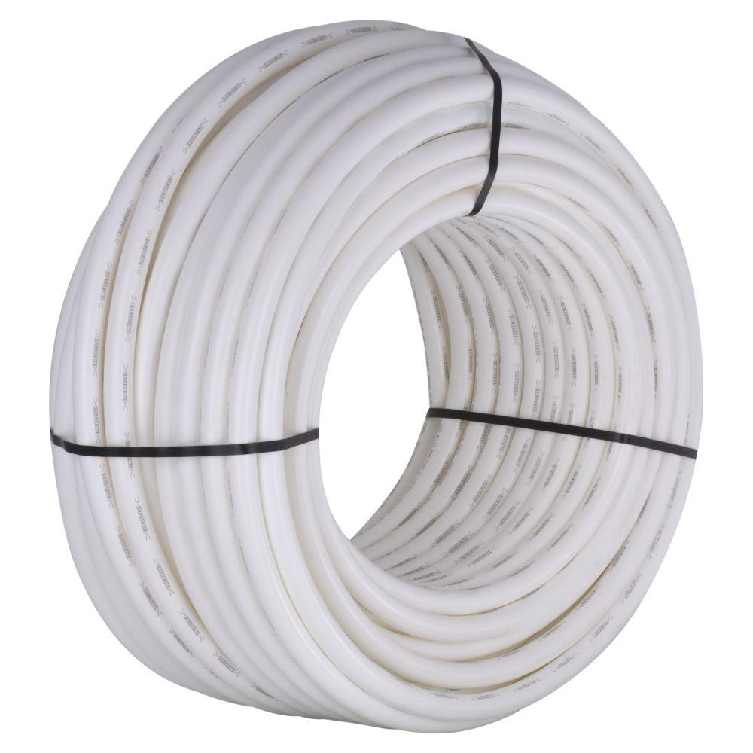
PEX Pipe Demonstrates high elasticity and durability
Notes:
Basically PVC pipe but more flexible

Slide 23
Questions?

Slide 24
Sources
[1] “Material Safety Data Sheet: PVC Plastic Pipe.” National Pipe, 27 Jan. 11AD, Material safety data sheet: PVC plastic pipe. (11AD, January 27). Retrieved from www.nationalpipe.com/pdf_files/msds-pvc.pdf.
[2] “Rolyan Small Clinic Pack A.” Performance Health, www.performancehealth.com/rolyan-small-clinic-pack-a.
[3] “Safety Data Sheet: PLA 3D Printer Filament/MakerBot PLA.” MakerBot, 26 Sept. 2016, images.makerbot.com/support/production/SDS-000002ENA.pdf.
[4]“Data Table of Infant Weight-for-Age Charts.” CDC , National Center for Health Statistics, 23 Aug. 2001, https://www.cdc.gov/growthcharts/html_charts/wtageinf.htm#females.
[5] “Data Table of Infant Height-for-Age Charts.” CDC , National Center for Health Statistics, 23 Aug. 2001, https://www.cdc.gov/growthcharts/html_charts/lenageinf.htm#females.
[6] “Size Guide.” Size Guide, www.minimerino.co.nz/size_guide.html.
[7] ​Perlut PT, Susan. Personal Interview. 19 Feb 2019.
[8] United States, Food & Drug Administration, “Walker, Mechanical, Poly Vinyl Chloride (Pvc).” Medical Devices Database: Product Classification, www.accessdata.fda.gov/scripts/cdrh/cfdocs/cfPCD/classification.cfm?ID=5296.

